Slide 1



Substance Use Awareness:
Nicotine, Cannabis, Fentanyl &
Talking to Your Child About Drugs
Concientización Sobre el Uso de Sustancias:
Nicotina, Cannabis, Fentanilo y
Cómo Hablar con su Estudiante Sobre las Drogas
Parent/Caregiver Presentation
Presentación para Padres de Familia / Proveedores de Cuidado
Fecha: PENDIENTE
Date: November 2,2023
Notes:
This presentation contains a video may be impactful to some participants. Please ensure that you have members of the multi-disciplinary school-site crisis team available to support as needed. To access the notes, please print the slides showing the notes.
Have paper and pens available for parents for note taking.
Remind participants:
Substance Abuse can be an extremely difficult and personal topic with which to engage. As such, we strongly encourage you to give the necessary attention to any feelings you may have experienced. That means, but not limited to, taking breaks with the content as needed, engaging in self-care practices during and after the presentation, and reaching out for help if you need it.
If you are concerned about your child, reach out to your child's school for help. If you or someone you know is in crisis, call or text 988. A crisis counselor is available 24 hours a day to support you.

Slide 2
Learning Objectives
Objetivos para el Aprendizaje
Learn about nicotine, cannabis, and fentanyl
Learn how to recognize the signs when someone is under the influence of a substance
Identify the signs of an opioid overdose
Identify ways to talk to your child about the dangers of substance use
Explore ways to check in with and monitor and supervise your child/children
Aprender sobre la nicotina, cannabis y fentanilo
Aprender a reconocer las señales cuando alguien está bajo la influencia de una sustancia
Identificar las señales de una sobredosis de opioides
Identificar maneras de hablar con su estudiante sobre los peligros del uso de sustancias
Explorar maneras de verificar y monitorear y supervisar a su estudiante
Notes:
Facilitator Notes:
Review Learning Objectives
Learn about nicotine, cannabis, and fentanyl
Learn how to recognize the signs when someone is under the influence of a substance
Learn how to identify the signs of an opioid overdose
Identify ways to talk to your child about the dangers of substance use
Explore the ways parents and caregivers can protect against substance use.
Recognize signs that your child may need help
Emphasize that this presentation is meant to:
Provide introductory information to common substances and trends. Additional learning is strongly recommended.
Empower parents/caregivers, not scare.

Slide 3
Welcome
Bienvenida
All caregivers are welcome and valued.
Do what you need to take care of yourself during our time together.
We are allies. You are the expert on your child(ren).
The Los Angeles Unified School District (LAUSD) has operated a Tobacco Use Prevention Education (TUPE) Program for the past 35 years. For the past 11 years, this program has been operated through LAUSD’s Beyond the Bell (BTB) Branch. These accomplishments occurred in part through community education, which included students, their families, and school staff.
Se da la bienvenida y valora a todos los proveedores de cuidado.
Haga lo que necesite hacer para cuidar de sí mismo durante nuestro tiempo juntos.
Somos aliados. Usted es el experto cuando se trata de su estudiante o sus estudiantes.
El Distrito Escolar Unificado de Los Ángeles (LAUSD, por sus siglas en inglés) ha operado un Programa de Educación para la Prevención del Uso del Tabaco (TUPE, por sus siglas en inglés) durante los últimos 35 años. Durante los últimos 11 años, este programa ha sido operado a través de la Oficina del programa Beyond de Bell (BTB, por sus siglas en inglés) del LAUSD. Estos logros ocurrieron en parte a través de la educación comunitaria, que incluyó a los estudiantes, sus familias y el personal de la escuela.
Notes:
Welcome Participants
Facilitator Notes:
We’re glad you’re here and want to start off by thanking you.
Throughout the module, you’ll hear the term “parents/caregivers” used interchangeably to refer to all caregivers including biological parents and adoptive parents, legal guardians, foster caretakers, and relative caregivers. We know you’re here because you care deeply about the wellbeing of a child(ren) in your life. We welcome you and value your participation.
We want to acknowledge that some of the topics we’ll address can be triggering. If at any point in the presentation you feel overwhelmed, we encourage you to do what you need to help regulate your nervous system; that could be taking deep breaths, drinking a cool glass of water, or warm cup of tea, stretching, moving your body – whatever helps you remain calm and present.
The TUPE Program has involved multi-agency collaboration, addressed district policy regarding tobacco use on campus, and reduced the use of tobacco, nicotine, cannabis, and hookah use among middle and high school students.
Lastly, we are here as your allies in this work. Our approach is centered in a "power-with" dynamic. We want to partner in this work. We see you as the expert of your children, and we are thankful you've allowed us to be an ally in supporting your child's wellbeing.

Slide 4
Strategic Plan
Plan Estratégico
Notes:
Facilitator Notes:
Review Strategic Plan Priority
Today’s training addresses one of the priorities outlined in LAUSD’s Strategic Plan under Pillar 2: Joy and Wellness. It is a priority of the district to create and deliver workshops that are focused on deepening parent/caregiver knowledge, skills, and dispositions to support their students' social and emotional needs.
LAUSD Strategic Plan
https://sites.google.com/lausd.net/lausdstrategicplan/home

Slide 5
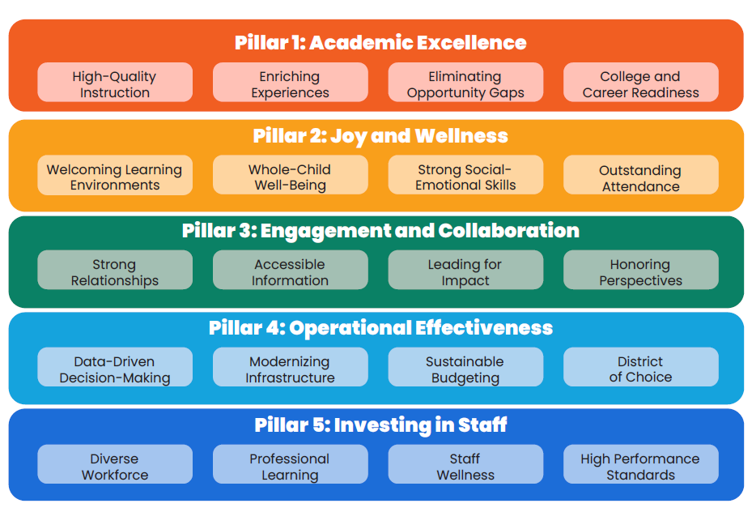
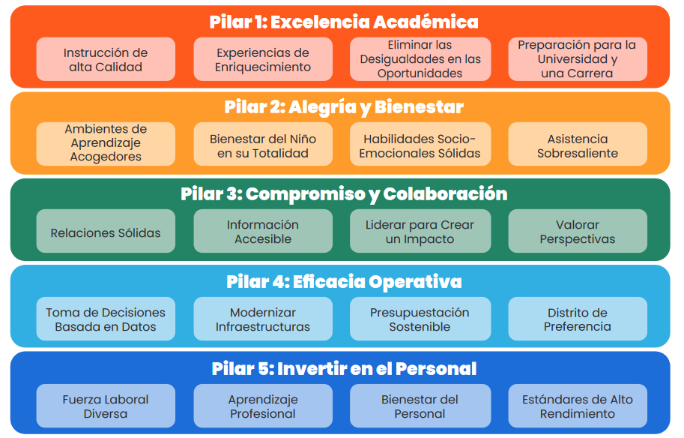
LAUSD 2022-2026 Strategic Plan
PLAN ESTRATÉGICO DE LAUSD
2022– 2026
Joy and Wellness
  Whole-Child Well-Being
  Strong Social-Emotional Skills
Alegría y Bienestar
  Bienestar Integral del Niño(a)
  Habilidades Socioemocionales Sólidas
Plan Estratégico de LAUSD
https://sites.google.com/lausd.net/lausdstrategicplan/ho

Slide 6

Reflection Activity
Actividad para Reflexionar
What gives me hope or strength during difficult times?
¿Qué me da esperanza o fuerza en los tiempos difíciles?
Notes:
Facilitator Notes:
Thinking about the dangers of substance use can feel overwhelming and scary as a caregiver.
We will engage in a reflection activity. What gives me hope or strength during hard times?"
Take a moment to make space for reflection about "what gives caregivers hope or strength during hard times?"
Hope is forward-looking and optimistic. It builds resilience and helps us push forward in the face of challenges. As we move through the information in this module, we encourage you to keep your reasons for keeping hope at the forefront of your learning.
Additional Facilitator Notes:
Encourage participation in the reflection activity through share-out, journaling, or elbow partner discussion. For virtual training, consider using the chat function. Participation method will vary by group size and in-person/virtual format.
Reflect back on what you have heard. Identify general categories, i.e.: “We heard wonderful examples of hope that come from having family support, community, spirituality and faith, our ability to problem-solve, reach out for help, etc.”

Slide 7
Substance Use Prevention Starts Early
Prevención del Uso de Sustancias
Comienza temprano
Substance Use Awareness:
Facts About Commonly Used Substances
Warning Signs, Talking with Your Child, Community Resources
Concientización sobre el uso de sustancias:
Datos sobre las sustancias de uso común
Señales de alerta, Cómo hablar con su hijo, Recursos de la comunidad
Notes:
Facilitator Notes:
As a parent, you are the biggest influence in your child’s life.
Having open and honest conversations is one of the most powerful ways to connect with our children and help them make healthy choices.
When addressing challenging topics like drug and alcohol use - it’s not about having a one-time “drug talk,” but rather tackling the subject through more frequent, organic conversations that evolve as your child gets older.
Teachable moments come up all the time — use these as natural opportunities to discuss substance use. From a young age, parents can begin to set clear expectations, rules, and messages for their children.
Today we will share some facts with you about two substances commonly used by youth and a third that is extremely dangerous. We will leave you with important messges to share during teachable moments.

Slide 8
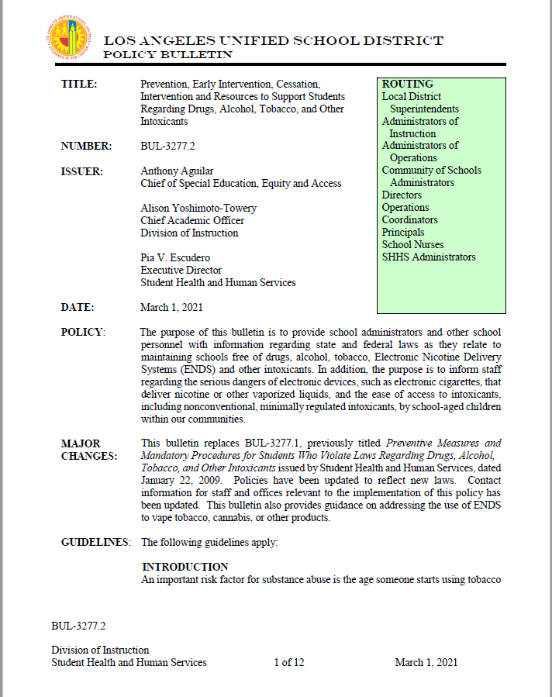
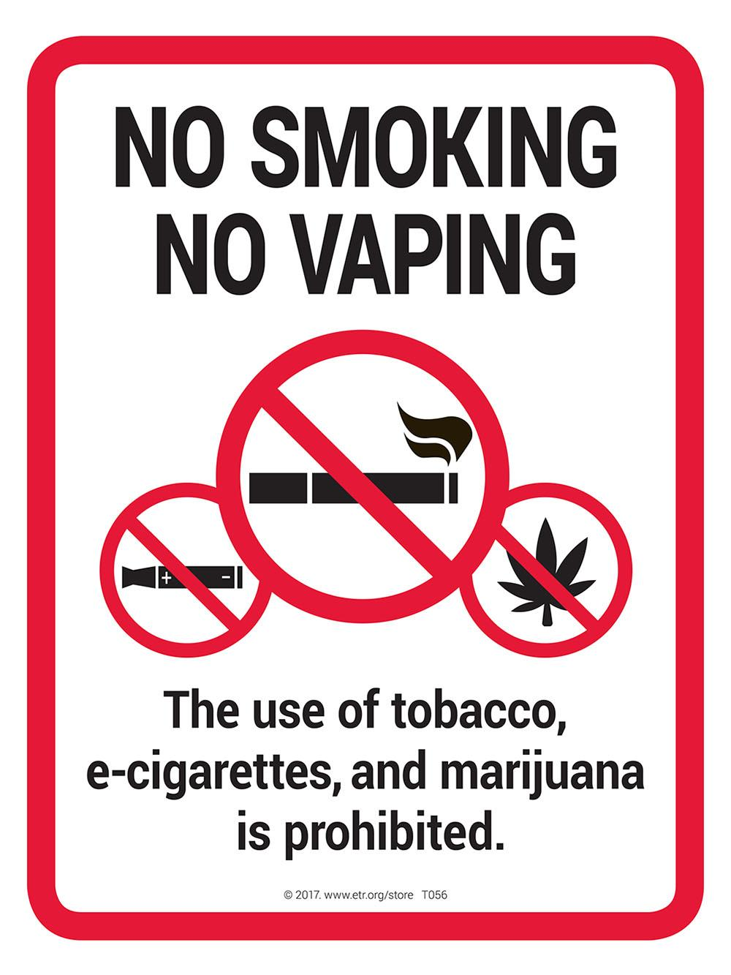
LAUSD Policy
Política de LAUSD
Notes:
Facilitator Notes:
Please know that the District has policies which help to maintain schools free of drugs, alcohol, tobacco, Electronic Nicotine Delivery Systems (ENDS) and other intoxicants.
One policy in particular, Bulletin 3277.2 Prevention, Early Intervention, Cessation, Intervention and Resources to Support Students Regarding Drugs, Alcohol, Tobacco, and Other Intoxicants,
informs staff regarding the serious dangers of electronic devices and the ease of access to intoxicants, by school-aged children within our communities.
BUL-3277.2
https://achieve.lausd.net/cms/lib/CA01000043/Centricity/domain/1189/pdfs/BUL-3277_2%20Prevention%20Early%20Intervention%20Cessation%20Intervention%20and%20Resources%20to%20Support%20Students.pdf

Slide 9

What We Know…
Lo que Sabemos…
Youth have access to a wide range of substances.
Some youth are taking risks: 50% of teenagers have misused a drug at least once.
Early drug abuse increases the likelihood of addiction.
Parents have a significant influence in their children’s decisions to experiment with alcohol and other drugs.
Los jóvenes tienen acceso a una amplia gama de sustancias.
Algunos jóvenes están tomando riesgos: Un 50 % de los adolescentes han abusado de una droga al menos una vez.
El abuso temprano de drogas aumenta la probabilidad de tener una adicción.
Los padres pueden influir significativamente en las decisiones que toman sus estudiantes de experimentar con el alcohol y otras drogas.
Administración de Servicios de Abuso de Sustancias y Salud Mental
https://www.samhsa.gov/data/
Notes:
Facilitator Notes:
Drug abuse has been a national health concern for decades. Trends change but the challenge remains the same.
Children and teens have access to a wide range of substances.
Not all youth use drugs and alcohol, but some are taking risks when it comes to drugs and alcohol; about 50% of teenagers have misused a drug at least once.
Brain science informs us that early drug abuse correlates with substance abuse problems later in life. Research tells us that starting use in childhood and adolescence increases the likelihood of addiction.
The good news - research shows that the number one reason teens decide not to use drugs are parents/caregivers. Study after study shows that parents make a huge impact on whether or not a child ends up experimenting and abusing drugs and alcohol at a young age. Parents have a significant influence in their children’s decisions to experiment with alcohol and other drugs.
Substance Abuse and Mental Health Services Administration. (2021). Key substance use and mental health indicators in the United States: Results from the 2020 National Survey on Drug Use and Health (HHS Publication No. PEP21-07-01-003, NSDUH Series H-56). Rockville, MD: Center for Behavioral Health Statistics and Quality, Substance Abuse and Mental Health Services Administration. Retrieved from https://www.samhsa.gov/data/

Slide 10
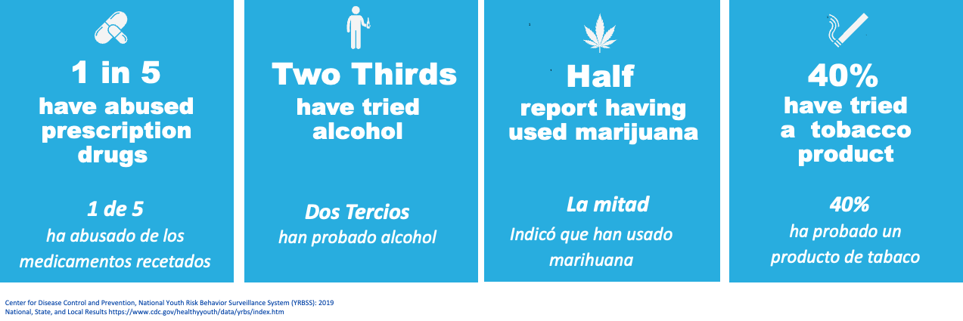
Prevalence
Prevalencia
According to the CDC by the time students are seniors in high school:
De acuerdo con los CDC, para cuando los estudiantes llegan al último año de preparatoria:
Centro para el Control y la Prevención de Enfermedades, Sistema Nacional de Vigilancia de Conductas de Riesgo Juvenil (YRBSS, por sus siglas en inglés): Resultados nacionales, estatales y locales 2019 https://www.cdc.gov/healthyyouth/data/yrbs/index.htm
Notes:
Facilitator Notes:
Review Prevalence Data
According to a guide developed by the Centers for Disease Control and Prevention, (CDC) by 12th grade:
•About 1 in 5 12th graders report using prescription medicine without a prescription.
•About two-thirds of students have tried alcohol.
•About half having used marijuana.
And 4 in 10, approximately 40%, have tried a tobacco product.

Slide 11
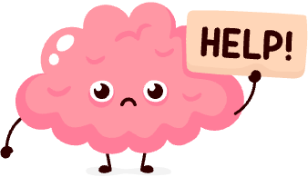
Any Use by Youth is a Concern
Cualquier Uso Por Parte de los Jóvenes es una Preocupación
Substance Abuse
Any drug or alcohol use by children and teens is considered substance abuse because it interferes with normal brain development.
Abuso de Sustancias
Cualquier consumo de drogas o alcohol por los niños y adolescentes se considera abuso de sustancias porque interfiere con el desarrollo normal del cerebro.
Director de NIDA, 5 de octubre de 2022. Extraído de https://nida.nih.gov/publications/principles-adolescent-substance-use-disorder-treatment-research-based-guide/director el 7 de noviembre de 2022
Notes:
Facilitator Notes:
Any use by children and teens is a concern.
Any drug or alcohol use by teenagers is considered drug abuse because these substances interfere with normal brain development.
Impact on brain development can increase the risk of cognitive, behavioral, or emotional problems later on. The young brain is at a much higher risk of developing dependence and addiction of substances.
NIDA. 2022, October 5. From the Director. Retrieved on 2022, November 7 from https://nida.nih.gov/publications/principles-adolescent-substance-use-disorder-treatment-research-based-guide/director

Slide 12
Nicotine
Nicotina
Notes:
Facilitator Notes:
The first substance we will cover is NICOTINE also known as TOBACCO, which is an illegal substance to consume by anyone under 21 years of age in California.

Slide 13
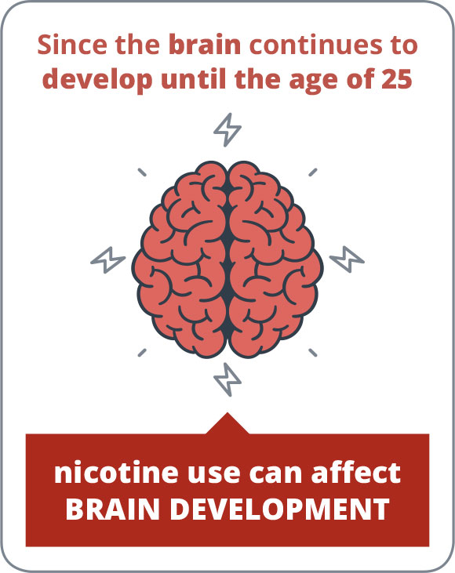
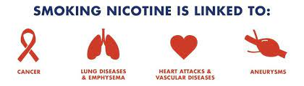
Nicotine Facts
Datos Sobre la Nicotina
A highly addictive drug in tobacco plants
Found in e-cigarettes
A stimulant
Contains harmful chemicals
Absorbed into the body and goes directly to the brain
Negatively impacts brain development
Link to mental health disorders
Una droga altamente adictiva en las plantas de tabaco
Se encuentra en los cigarrillos electrónicos
Un estimulante
Contiene sustancias químicas dañinas
Absorbido por el cuerpo y se dirige directamente al cerebro
Afecta negativamente el desarrollo del cerebro
Vínculo con los trastornos de salud mental
Asociación Americana del Pulmón https://www.lung.org/quit-smoking/smoking-facts/health-effects/nicotine
Notes:
Facilitator Notes:
Nicotine is a HIGHLY addictive chemical found in tobacco plants and all tobacco products like cigarettes, cigars, smokeless tobacco and e-cigarettes. It’s the reason why normal cigarette smokers have such a hard time quitting.
Nicotine is a stimulant, which means it raises levels of physical or psychological activity in the body.
Nicotine contains harmful chemicals that negatively affect the brain and the body.
When nicotine is absorbed into the body, it goes directly to the brain.
Adolescents who consume nicotine are in danger of suffering long term effects because nicotine use during adolescence can change the brain chemistry.
Nicotine use during adolescence has been linked to lasting mental health disorders, which include memory, attention, and learning.
American Lung Association:
https://www.lung.org/quit-smoking/smoking-facts/health-effects/nicotine
National Cancer Institute
https://www.cancer.gov/about-cancer/causes-prevention/risk/tobacco/cessation-fact-sheet#:~:text=Of%20the%20more%20than%207%2C000,least%2069%20can%20cause%20cancer.

Slide 14
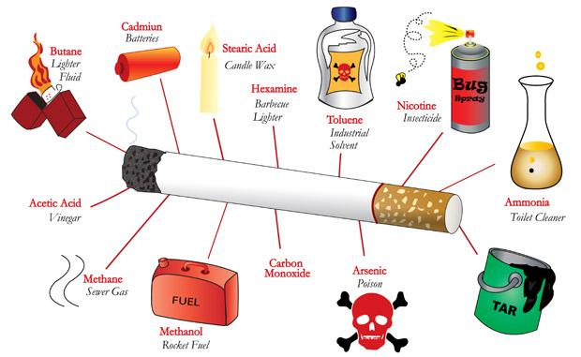
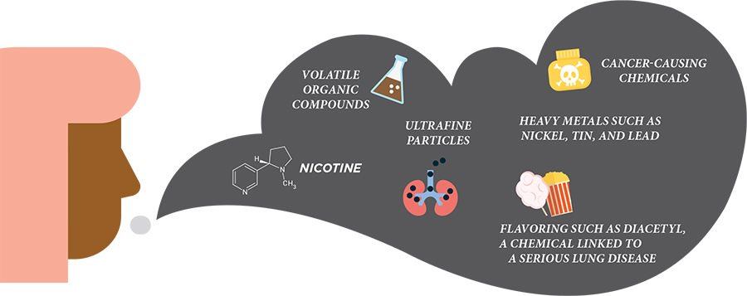
What makes nicotine harmful?
¿Qué hace que la nicotina sea dañina?
Traditional cigarettes contain over 7,000 chemicals
Some chemicals cause cancer
Other chemicals in cigarettes are toxins
Harmful ingredients in vape aerosol
Los cigarrillos tradicionales contienen más de 7,000 productos químicos
Algunas sustancias químicas causan cáncer
Otros productos químicos en los cigarrillos son toxinas
Ingredientes dañinos en aerosol de los cigarrillos electrónicos o conocido en inglés como VAPE
CDC:
https://www.cdc.gov/tobacco/basic_information/e-cigarettes/about-e-cigarettes.html
Notes:
Facilitator Key Points:
These are some of the most harmful chemicals in nicotine and tobacco products. They will harm the brain and the body.
Of the more than 7,000 chemicals in tobacco smoke, at least 250 are known to be harmful. Of the 250 known harmful chemicals in tobacco smoke, at least 69 can cause cancer.
E-cigarettes contain harmful and potentially harmful ingredients, including nicotine, heavy metals like lead, volatile organic compounds, and cancer-causing agents
Sources:
CDC:
https://www.cdc.gov/tobacco/basic_information/e-cigarettes/about-e-cigarettes.html
Medical News Today:
https://www.medicalnewstoday.com/articles/vaping-vs-smoking#effects-of-smoking

Slide 15
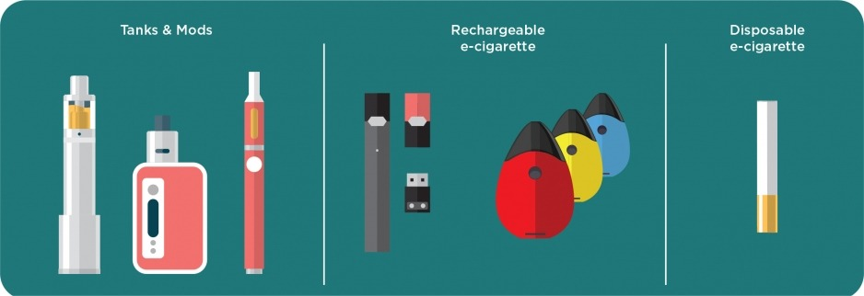
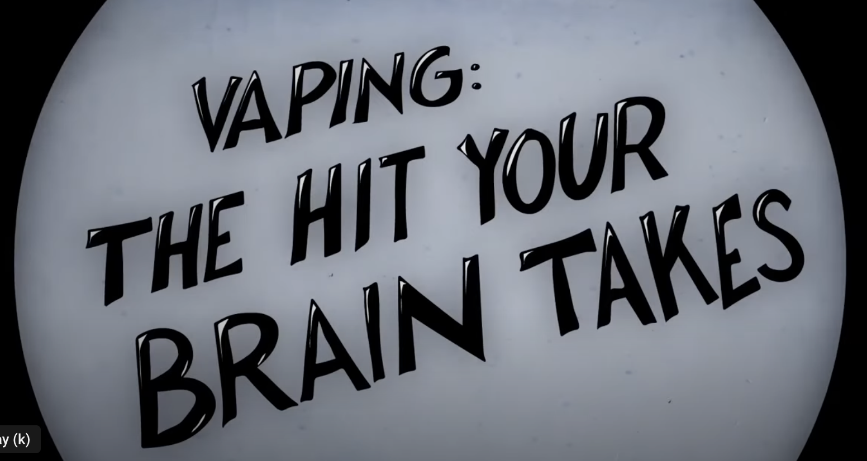
E-cigarette Facts
Datos sobre los E-Cigarrillos
Electronic devices used for vaping that take in and heat liquid, producing an aerosol
Also known as e-cigs, vapes, vaporizers, hookahs, JUUL, etc.
Users can get more nicotine from e-cigarettes compared to regular cigarettes
Kid-friendly flavors make it appealing
Also used to inhale cannabis and other drugs
Negative impact on the adolescent brain
Dispositivos electrónicos utilizados para vapear que absorben y calientan el líquido, produciendo un aerosol
También conocido como e-cigs, vapeador, vaporizadores, pipas de agua, JUUL, etc.
Los usuarios pueden consumir más nicotina de los cigarrillos electrónicos en comparación con los cigarrillos normales
Los sabores apetitosos para los niños los hacen atractivos
También se usa para inhalar cannabis y otras drogas
Impacto negativo en el cerebro de los adolescentes
Centros para el Control de Enfermedades
https://www.cdc.gov/tobacco/basic_information/e-cigarettes/pdfs/OSH-E-Cigarettes-and-Youth-What-Educators-and-Coaches-Need-to-Know-508.pdf
Notes:
Facilitator Notes:
Let’s look at some facts about e-cigarettes.
E-cigarettes are electronic devices that heat a liquid and produce an aerosol, or mix of small particles in the air. They look like regular cigarettes or pipes or other items commonly used by youth like USB flash drives, pens, or other items. They may use a battery or may be charged. Using an e-cigarette is sometimes called vaping.
Some vape product labels do not disclose that they contain nicotine and are marketed as containing 0% nicotine.
Users can consume even more nicotine through e-cigarettes. Users can buy extra-strength cartridges, which have a higher concentration of nicotine, or they can increase the e-cigarette voltage to get a greater hit of the substance.
Companies have made flavored tobacco to appeal and attract youth. In November 2022, CA voters passed SB 793 prohibiting tobacco retailers from selling flavored tobacco products.
Some e-cigarettes are also used to vape cannabis and other drugs.
Centers for Disease Control
https://www.cdc.gov/tobacco/basic_information/e-cigarettes/pdfs/OSH-E-Cigarettes-and-Youth-What-Educators-and-Coaches-Need-to-Know-508.pdf

Slide 16
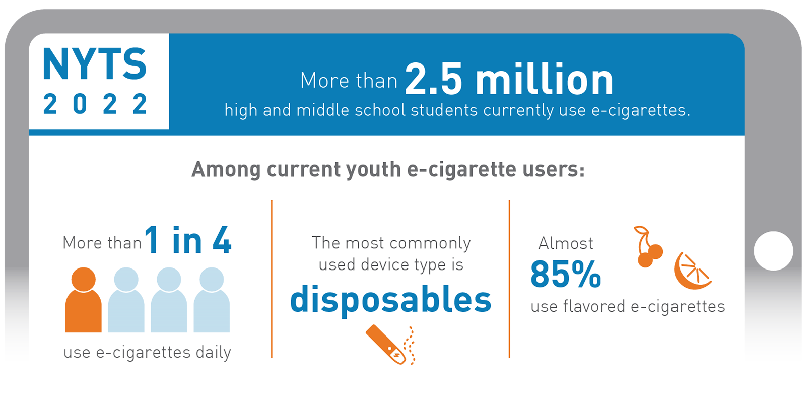
E-cigarette Use by Youth
Uso de los cigarrillos electrónicos por los jóvenes
2022 e-cigarette use remained a top concern for the Federal Drug Administration
About 1 in 10 (2.5 million) middle and high school students used e-cigarettes within the past 30 days
Currently, 14.1% (2.14 million) high school students and 3.3% (380,000) middle school students reported current e-cigarette use
2022 El uso de cigarrillos electrónicos siguió siendo una de las principales preocupaciones de la Administración para el Control de la Drogas
Aproximadamente 1 de cada 10 (2.5 millones) estudiantes de intermedia y preparatoria usaron cigarrillos electrónicos en los últimos 30 días
En la actualidad, el 14.1 % (2.14 millones) de estudiantes de preparatoria y el 3.3 % (380,000) de intermedia reportaron el uso actual de cigarrillos electrónicos
Administración de Alimentos y Medicamentos de EE.UU
https://www.fda.gov/tobacco-products/youth-and-tobacco/results-annual-national-youth-tobacco-survey#:~:text=2022 %20Findings%20on%20Youth%20E%2DCigarette%20Use,-In%20October%202022&text=In%202022%2C%20about%201%20in,(past%2030%2Dday).&text=14.1%25%20(2.14%20million)%20of,reported%20current%20e%2Dcigarette%20use</s>202022 % 201 %2030 %1 %25 %14 %
Notes:
Facilitator Notes:
Although rates of youth vaping remained steady between 2021 - 2022, we still have approximately 1 in 4 youth reporting daily use of e-cigarettes in the U.S.
This is particularly alarming due to the high addiction properties of nicotine on the youth developing brain.
FDA National Youth Tobacco Survey
https://www.fda.gov/tobacco-products/youth-and-tobacco/results-annual-national-youth-tobacco-survey#:~:text=2022%20Findings%20on%20Youth%20E%2DCigarette%20Use,-In%20October%202022&text=In%202022%2C%20about%201%20in,(past%2030%2Dday).&text=14.1%25%20(2.14%20million)%20of,reported%20current%20e%2Dcigarette%20use.

Slide 17


Recognizing the Signs of Nicotine Dependence
Reconocer las Señales de la Dependencia a la Nicotina
Dizziness/lightheadedness
Sleep problems
Blood-flow changes
Headaches
Shortness of breath
Racing heartbeat
Diarrhea
Nausea
Dry mouth
Mareos/aturdimiento
Problemas para dormir
Cambios en el flujo sanguíneo
Dolores de cabeza
Dificultad para respirar
Latidos del corazón rápidos
Diarrea
Náuseas
Boca seca
Noticias médicas hoy
https://www.medicalnewstoday.com/articles/240820
Notes:
Facilitator Notes:
Here are some of the common side effects of consuming nicotine.
Some of the side effects develop over time, but some are present with every dose of nicotine taken.
Medical News Today
https://www.medicalnewstoday.com/articles/240820
Tobacco Free Life:
https://tobaccofreelife.org/why-quit-smoking/smoking-effects/nicotine-effects/

Slide 18


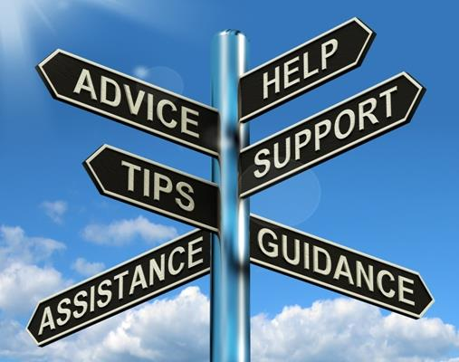
Scenario #1
Situación Hipotética
Usted sorprende a su estudiante vapeando. ¿Qué hace?
You catch your child vaping. What do you do?
Notes:
Facilitator Notes:

Slide 19
Cannabis/Marihuana
Notes:
Facilitator Notes:
Next, we will share facts about CANNABIS, ALSO KNOWN AS MARIJUANA.

Slide 20
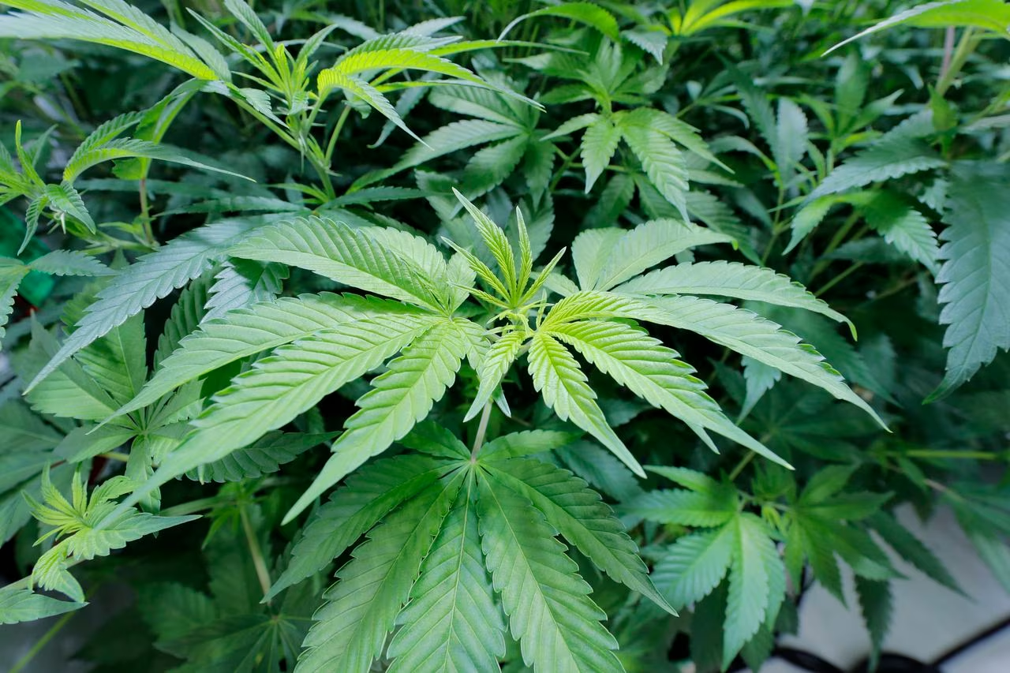
Cannabis/Marijuana Facts
Datos Sobre el Cannabis/Marihuana
Produced from the cannabis sativa plant
Also called marijuana, weed, pot, grass, dope, bud, blunt, 420, etc.
Main active chemical is THC, Tetrahydrocannabinol
THC creates addiction
THC can impair and alter the mind
Cannabidiol (CBD) compound contains less than 0.3% THC
May cause marijuana use disorder
Can be smoked, vaped, eaten
Producido de la planta Cannabis sativa
También se llama marihuana, hierba, mota, ganja, yerba, cana, porro, 420, etc.
El principal químico activo es el THC, tetrahidrocannabinol
El THC crea una adicción
El THC puede perjudicar y alterar la mente
El compuesto cannabidiol (CBD) contiene menos de 0.3 % de THC
Puede causar trastorno por consumo de marihuana
Se puede fumar, vapear, comer
Centro Nacional de Inteligencia de Drogas https://www.justice.gov/archive/ndic/pubs3/3593/index.htm#:~:text=High%20doses%20of%20marijuana%20may,%2C%20anxiety%2C%20and%20panic%20attacks
Notes:
Facilitator Notes:
Marijuana comes from cannabis sativa, which is the scientific name of the plant. It is known as cannabis, weed, pot, or dope and refers to the dried flowers, leaves, stems, and seeds of the cannabis plant.
The cannabis plant contains more than 100 compounds (or cannabinoids) that include THC and CBD. THC is the main compound in Cannabis that can impair and alter the mind. Delta 8 and Delta 10 are compounds extracted from the Cannabis plant.
Cannabidiol (CBD) does not impair, which means it does not cause a high, because it has less than 0.3% of THC. Typically, CBD comes from the Hemp plant.
People who frequently use marijuana may develop marijuana use disorder which means they can’t stop using marijuana. When individuals start using in their adolescent years, they have a greater risk of developing marijuana use disorder, which is an addiction to marijuana.
Excessive chemicals are sometimes used to extract Delta 8 and Delta 10 making the compounds very harmful.
Main points being Delta-8 and Delta-10 can currently be sold at tobacco and vape shops without special licensing. Also, many of these products have psychoactive effects to the user similar to regular THC.
National Drug Intelligence Center https://www.justice.gov/archive/ndic/pubs3/3593/index.htm#:~:text=High%20doses%20of%20marijuana%20may,%2C%20anxiety%2C%20and%20panic%20attacks
National Center for Complementary and Integrative Health
https://www.nccih.nih.gov/health/cannabis-marijuana-and-cannabinoids-what-you-need-to-know
Centers for Disease Control
https://www.cdc.gov/marijuana/featured-topics/what-we-know-about-marijuana.html
Pittsburg City Paper
https://www.pghcitypaper.com/pittsburgh/delta-10-vs-delta-8-whats-the-difference-22709804

Slide 21
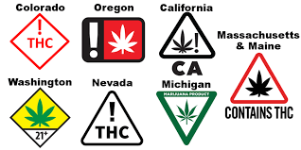
Facts About Edibles
Datos Sobre los Productos Comestibles de Marihuana o Edibles
Foods or drinks containing marijuana or THC
Differing effects of eating and drinking edibles vs. smoking and vaping
Smoking marijuana gives instant effect
Differing effects of THC in edibles based on potency and/or the individual
Food and Drug Administration (FDA) does not monitor edibles
Can mimic regular foods that do not contain marijuana
Label shows products containing cannabis
Producido de la planta Cannabis sativa
También se llama marihuana, hierba, mota, ganja, yerba, cana, porro, 420, etc.
El principal químico activo es el THC, tetrahidrocannabinol
El THC crea una adicción
El THC puede perjudicar y alterar la mente
El compuesto cannabidiol (CBD) contiene menos de 0.3 % de THC
Puede causar trastorno por consumo de marihuana
Se puede fumar, vapear, comer
Salud Pública del Condado de Los Ángeles
http://publichealth.lacounty.gov/sapc/MDU/DE/MarijuanaEdiblesFactSheet040416.pdf
Notes:
Facilitator notes:
Many cannabis companies make food and drink products infused with cannabis called edibles.
Edibles come in many shapes and types and can look like regular foods that don’t contain marijuana.
The effects of eating or drinking edibles can be very different from smoking marijuana or using a vaporizer.
When people smoke marijuana, they feel the effect almost instantly. When a person starts to feel the effects, they may stop smoking, which can control the dose. However, when people eat or drink marijuana, their bodies take longer to digest and metabolize it (break it down) before they feel the effects. By the time they feel “high,” it’s too late to control the dose.
How someone will react to edibles depends on the type and strength of the edibles, the person’s body mass, chemistry, metabolism, and the amount consumed.
The FDA does not monitor edibles and as a result a marijuana edible label may not correctly represent the list or amounts of ingredients in the product.
http://publichealth.lacounty.gov/sapc/MDU/DE/MarijuanaEdiblesFactSheet040416.pdf

Slide 22
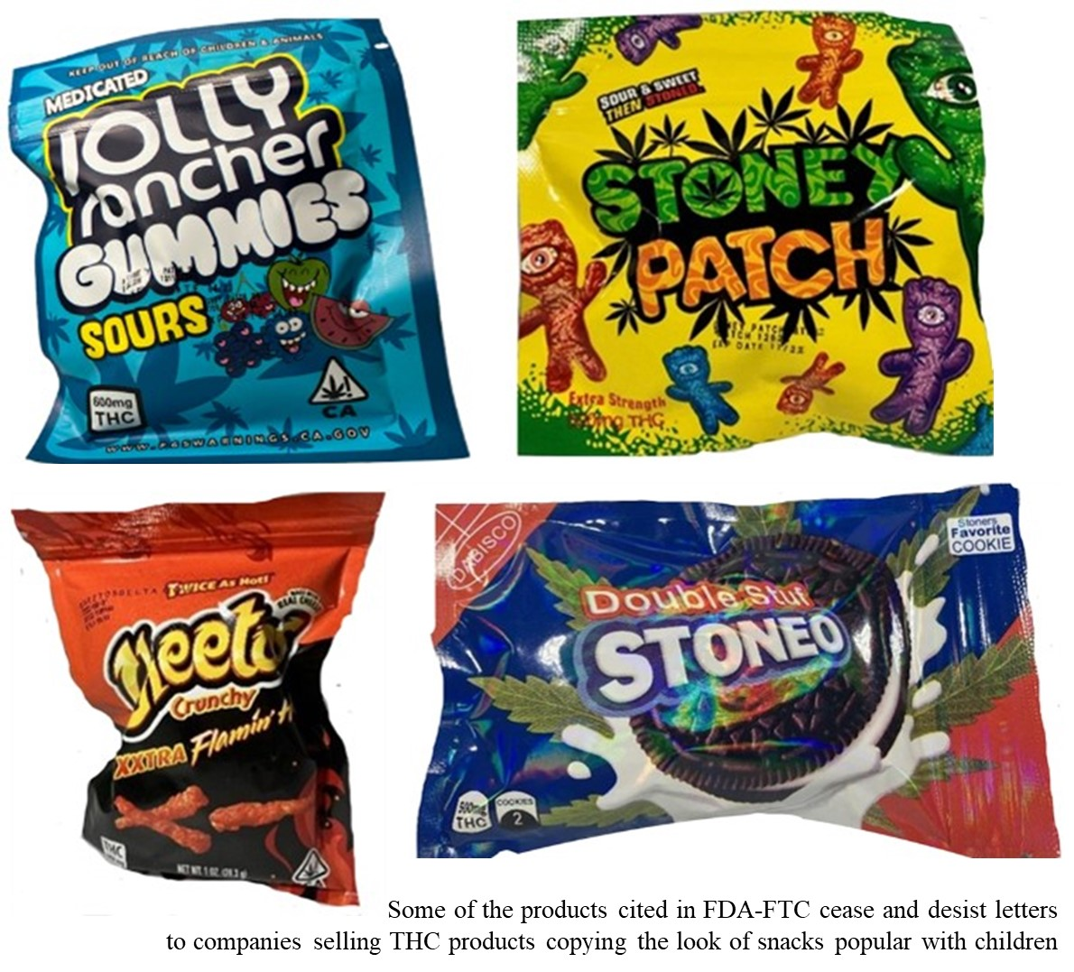
Common Edibles
Productos Comestibles de Marihuana que Son Comunes
How do you engage your children in discussions about accepting food or drinks from friends or others?
What do you expect your children to do when they are offered food or drinks?
¿Cómo puede usted tener conversaciones con sus hijos sobre la aceptación de alimentos o bebidas de amigos u otras personas?
¿Cuál es la expectativa de sus hijos cuando se les ofrece comida o bebidas?
Notes:
Facilitator Notes:
As I mentioned, cannabis product manufacturers make cannabis edibles look like popular snacks, which make them attractive to children.
Often times, the amount of THC in edibles is much higher than the recommended dose for adults. Children can mistaken edibles for regular food or candy and can become very sick after eating them.
With this information in mind, let’s discuss the following questions:
How do you engage your children in discussions about accepting food/drinks from friends or others?
What do you expect your children to do when they are offered food or drinks?
Problem-solving: Conversations about drugs and alcohol help your child develop problem-solving skills that build confidence and resilience. Talking through scenarios, exit strategies, practicing “No, Thanks”, helps your child work through problems in a thoughtful way.
Healthy Boundary Setting: In order to set healthy boundaries, children need to learn how to identify what they need, where their limits are, and the types of interactions with which they are comfortable. When children have these skills they are less inclined to participate in negative behavior.
Lastly, don’t expect all conversations with your children to be perfect. They won’t be. But sticking to these conversation goals will make it more likely that your kids will come to you if they are in trouble.
CDC
https://www.cdc.gov/marijuana/health-effects/poisoning.html

Slide 23
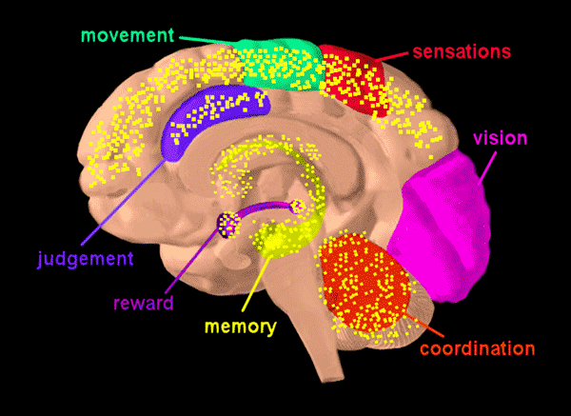
Recognizing the Signs of Cannabis Use
Reconocer las Señales del Uso de Cannabis
Euphoria
Dry mouth
Increased appetite
Rapid heart rate
Red eyes
Slowed reaction times
Anxiety
Memory loss
Euforia
Boca seca
Aumento del apetito
Frecuencia cardiaca rápida
Ojos rojos
Tiempo de reacción más lento
Ansiedad
Pérdida de memoria
National Drug Intelligence Center
https://www.justice.gov/archive/ndic/pubs3/3593/index.htm#:~:text=High%20doses%20of%20marijuana%20may,%2C%20anxiety%2C%20and%20panic%20attacks
CDC
https://www.cdc.gov/marijuana/health-effects/teens.html
Notes:
Facilitator Notes:
Here are some of the common symptoms of exposure to Cannabis/THC. Give participants time to browse the list.
National Drug Intelligence Center
https://www.justice.gov/archive/ndic/pubs3/3593/index.htm#:~:text=High%20doses%20of%20marijuana%20may,%2C%20anxiety%2C%20and%20panic%20attacks
CDC
https://www.cdc.gov/marijuana/health-effects/teens.html
Village Behavioral Health
https://www.villagebh.com/addiction/marijuana/symptoms-signs-effects/

Slide 24


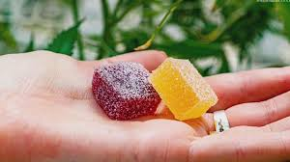
Scenario #2
Situación Hipotética #2
Su estudiante le cuenta que su mejor amigo le ofreció un producto comestible de marihuana. Ella le cuenta que se lo comió porque se sintió presionada a hacerlo. ¿Cómo reaccionaría?
Your child informs you that her best friend offered her an edible. She said she ate it because she felt pressured into doing it. How do you respond?
Notes:
Facilitator Notes:
Forms pairs or tri-ads
Read the scenarios aloud to the group
Give participants four minutes to respond to the scenarios in their small groups
Invite participants to share their ideas with the whole group

Slide 25
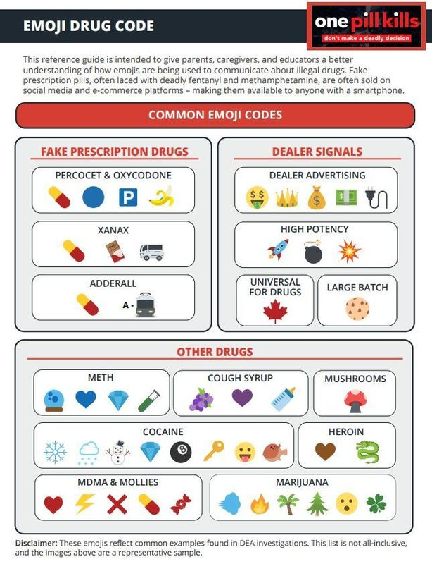
Illegal Drug Activity through Social Media
Relación Entre las Redes Sociales y el Uso de Sustancias
Some social media apps reportedly used
by drug trafficking organizations
to sell illicit drugs:
Instagram
Snapchat
TikTok
Tumblr
Twitch
YouTube
Communication about drugs:
Emojis
#Hashtags
Algunas aplicaciones de las redes sociales son utilizadas por las organizaciones de tráfico de drogas para vender drogas ilegales:
Instagram
Snapchat
TikTok
Tumblr
Twitch
YouTube
Comunicación sobre las drogas:
Emojis
#Hashtags
DEA
https://www.dea.gov/sites/default/files/2021-12/Emoji%20Drug%20Code%20PDF_Final.pdf
Notes:
Facilitator Notes:
The Drug Enforcement Administration is aware of drug trafficking organizations using emojis to sell counterfeit pills and other illicit drugs on social media and through e-commerce.
Here you see common emojis used by individuals who seek to purchase drugs from suppliers via social media and specific emojis used for prescription pills, dealer signals, and other drugs.
Through different hashtags (#s) teens can be exposed to offers from dealers to buy drugs through various social sites.
Source: https://www.dea.gov/sites/default/files/2021-12/Emoji%20Drug%20Code%20PDF_Final.pdf

Slide 26
Emojis Code

Slide 27

Relationship between Social Media and Substance Use
Relación Entre las Redes Sociales y el Uso de Sustancias
Social networking sites offer new and dangerous opportunities for adolescents to be exposed to drugs.
Sites provide an environment where kids are exposed to famous, “influencer,” and normal people alike engaging in risky behaviors involving drugs and alcohol.
Frequently viewing sites with images of “kids drunk, passed out, or using drugs” normalizes the behavior for teens.
Teens are uniquely vulnerable to the effects of what they see on social media.
Los sitios de las redes sociales ofrecen nuevas y peligrosas oportunidades para que los adolescentes sean expuestos a las drogas.
Los sitios proveen un entorno en el que los niños son expuestos a famosos, influencers y personas normales al igual que demuestran comportamientos riesgosos con las drogas y alcohol.
Ver con mayor frecuencia sitios con imágenes de “jóvenes borrachos, desmallados, o usando drogas” normaliza el comportamiento de los jóvenes.
Los adolescentes son específicamente vulnerables a los efectos de lo que ven en las redes sociales.
Recent studies show that 75% of teenagers seeing photos on social networking sites of other young people smoking weed or drinking alcohol encourages them to experiment in the same way.
Estudios recientes demuestran que 75% de los adolescentes que ven fotos en los sitios de las redes sociales de otros jóvenes fumando marihuana o bebiendo alcohol los motiva a experimentar en maneras similares.
Addiction Center: The Guide for Addiction and Recovery
https://www.addictioncenter.com/community/social-media-teen-drug-use/
Drugfree.org: Partnership to End Addiction:
https://drugfree.org/
Notes:
Facilitator Notes:
Young people experimenting with drugs and alcohol is nothing new.
While social media can be fun, inspiring and can help build community, it also creates new and dangerous opportunities for kids to be exposed to drugs.
Social networking sites like Instagram, Facebook, and Snapchat provide an environment where kids are exposed to famous, "influencer", and normal people, like friends and family, engaging in risky behaviors involving drugs and alcohol.
This type of exposure desensitizes children to risky behaviors at a younger age. Some of the content normalizes and glamorizes behavior such as illicit and prescription drug use as well as binge drinking. It makes teens wrongly believe it’s appropriate to do the same.
Because of their age, teens are highly susceptible to peer influences and pressure. Teens are uniquely vulnerable to the effects of what they see on social media.
Recent studies show that 75% of teenagers seeing photos on social networking sites of other young people smoking weed or drinking alcohol encourages them to experiment in the same way.
In the last part of this presentation, we will discuss what you can do to protect your children from social media influences.
Resources:
Addiction Center: The Guide for Addiction and Recovery
https://www.addictioncenter.com/community/social-media-teen-drug-use/
Drugfree.org: Partnership to End Addiction:
https://drugfree.org/

Slide 28
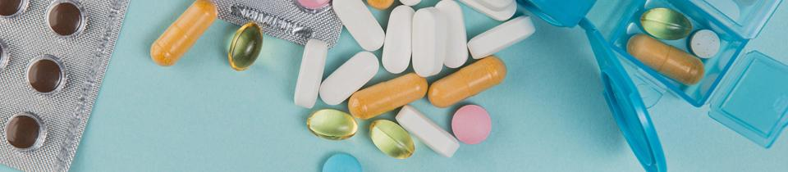
Fentanyl
Fentanilo
LAUSD Office of the Chief Medical Director
https://www.lausd.org/Page/18694
Notes:
Facilitator Notes:
Throughout the US there is an increase in unintended fentanyl overdose. Unintended means the user did not plan or have in mind consuming fentanyl.
But what exactly is fentanyl?
How do we know if a substance has fentanyl in it?
We will provide you with information about fentanyl in the next portion of this presentation
Write this on the board:
LAUSD Office of the Chief Medical Director
https://www.lausd.org/Page/18694

Slide 29
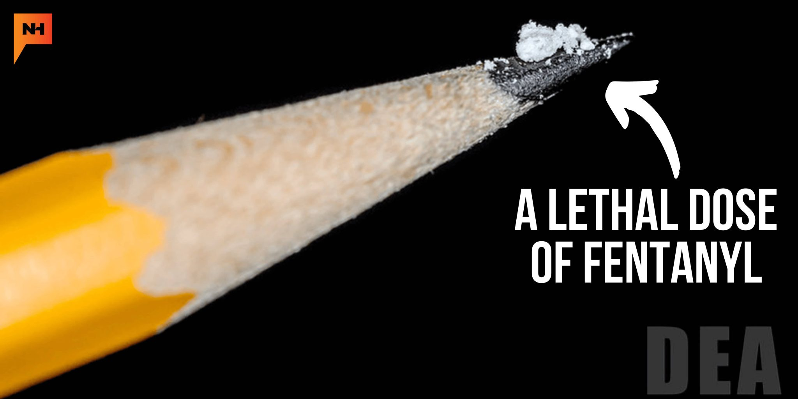

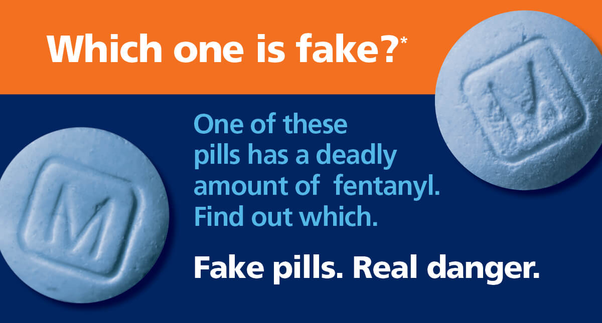
What is Fentanyl?
¿Qué es el Fentanilo?
Synthetic, man-made, opioid much more potent than heroin and morphine
Prescribed and/or illegal drug
Tasteless and odorless
Mixed with other drugs and laced in counterfeit pills
“Rainbow” fentanyl
Small quantity, 5-7 grains of salt, can have a deadly effect
Opioide sintético, artificial, mucho más potente que la heroína y morfina
Recetado y/o drogas ilegales
Sin sabor y olor
Mezclado con otras drogas y píldoras falsificadas.
Fentanilo arcoíris
Cantidades pequeñas, 5-7 granos de sal, pueden tener un efecto mortal
National Institute of Drug Abuse https://nida.nih.gov/research-topics/trends-statistics/infographics/what-fentanyl
DEA
https://www.dea.gov/press-releases/2022/08/30/dea-warns-brightly-colored-fentanyl-used-target-young-americans
Notes:
Facilitator notes:
Let’s deepen our understanding of what fentanyl is and why it is so deadly.
Additional Facilitator notes:
Encourage participation by asking participants: Do you know how much fentanyl is enough to cause an overdose?
Invite responses.
Just 2 milligrams can kill a person. Do you know how much is 2mm?
Click return and when the picture of the pencil appears, highlight that the small amount on the tip of the pencil is enough to cause an overdose and/or death.
Click return again and highlight the following:
Fentanyl is a synthetic opioid, which means it was man-made, that is 50 times more potent than heroin and 100 times more potent than morphine.
It can be prescribed by a doctor to treat severe pain, but it can also be illegally sold and used.
Illegal fentanyl, known as “street fentanyl” is made into liquids, powder, and counterfeit pills and is dangerous.
Many users are exposed to fentanyl without knowing, while others use it intentionally because of its potency.
Substances may be laced with fentanyl long before they reach the friends or friends of friends that teens trust.
The DEA has noted an increase in confiscating bright colored fentanyl being sold in cities across the country including California.
It is being seized in multiple forms, including pills, powder, and blocks that resembles sidewalk chalk.
It is assumed that the bright colored product (which resembles street chalk) is being marketed for youth due to it’s bright colors which resemble candy products.
While one pill may not be deadly, another one could be.
National Institute of Drug Abuse
https://nida.nih.gov/research-topics/trends-statistics/infographics/what-fentanyl
CA Dept of Public Health
www.cdph.ca.gov/Programs/OPA/Pages/Communications-Toolkits/Fentanyl-Overdose-Prevention.aspx
DEA
https://www.dea.gov/press-releases/2022/08/30/dea-warns-brightly-colored-fentanyl-used-target-young-americans
LAUSD Office of the Chief Medical Director
https://www.lausd.org/Page/18694

Slide 30
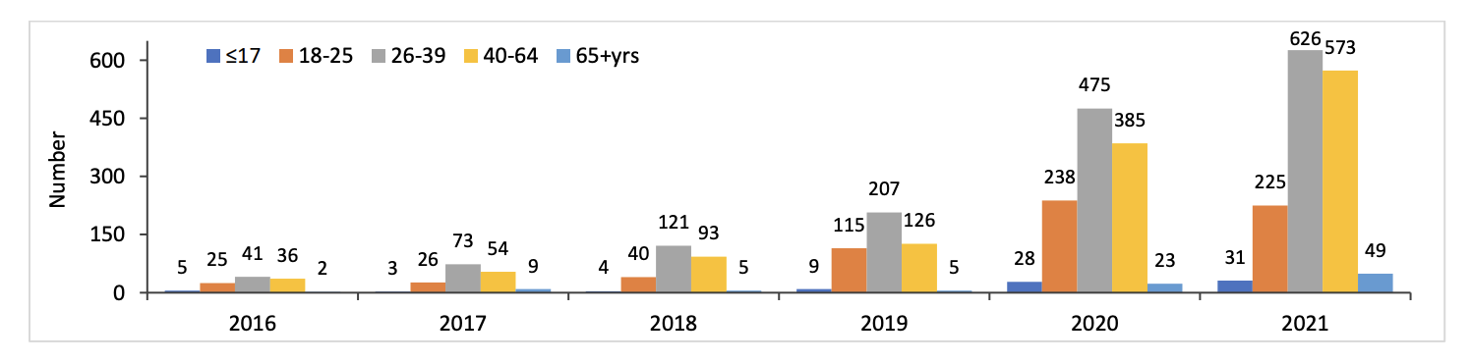
Fentanyl in Los Angeles County
Fentanilo en el Condado de Los Ángeles
Fentanyl Overdose Deaths by Age, Los Angeles County, 2016 - 2021
Muertes por sobredosis de fentanilo por edad, Condado de Los Ángeles, 2016-2021
Data Report: Fentanyl Overdoses in Los Angeles County. Health Outcomes and Data Analytics Branch, Substance Abuse Prevention and Control, Los Angeles County Department of Public Health, November 2022.
Notes:
Facilitator Notes:
The data above represents the number of LA County residents who have died to fentanyl poisoning since 2016.
Give the participants 2 minutes to examine the chart. After 2 minutes, ask, What do you notice and what do you wonder?
After participants have shared, share the bullets below if no one made reference to these points:
There has been a significant increase in deaths since 2016 as is evidenced by the this graphic image.
From 2016 - 2018 rates of youth overdose deaths were maybe 3-5 per year. In 2021 that number increased to 31 deaths.
Also, 18-25 year old residents represent a significant proportion of those who have passed due to fentanyl overdose.
Our goal is to work together to decrease these numbers of overdose hospitalizations and death due to fentanyl.
Data Report: Fentanyl Overdoses in Los Angeles County. Health Outcomes and Data Analytics Branch, Substance Abuse Prevention and Control, Los Angeles County Department of Public Health, November 2022.

Slide 31
Just One Pill Can Kill
This video was produced by the
United States Drug Enforcement Administration
https://lausd.wistia.com/medias/ker8foz4d6
Notes:
This presentation contains a video may be impactful to some participants. Please ensure that you have members of the multi-disciplinary school-site crisis team available to support as needed. Please enable closed captioning for your audience as needed.
Allow students time to process the video
After the video has been played state the following:
Remind students:
Substance abuse can be an extremely difficult topic. We strongly encourage you to give the necessary attention to any feelings or stress you may have experience after watching the video. That means, but not limited to, taking breaks with the content as needed, engaging in self-care practices during and after the presentation, and reaching out to a staff member for help if you need it.
If you or someone you know is in crisis, call or text 988. A crisis counselor is available 24 hours a day to support you.

Slide 32
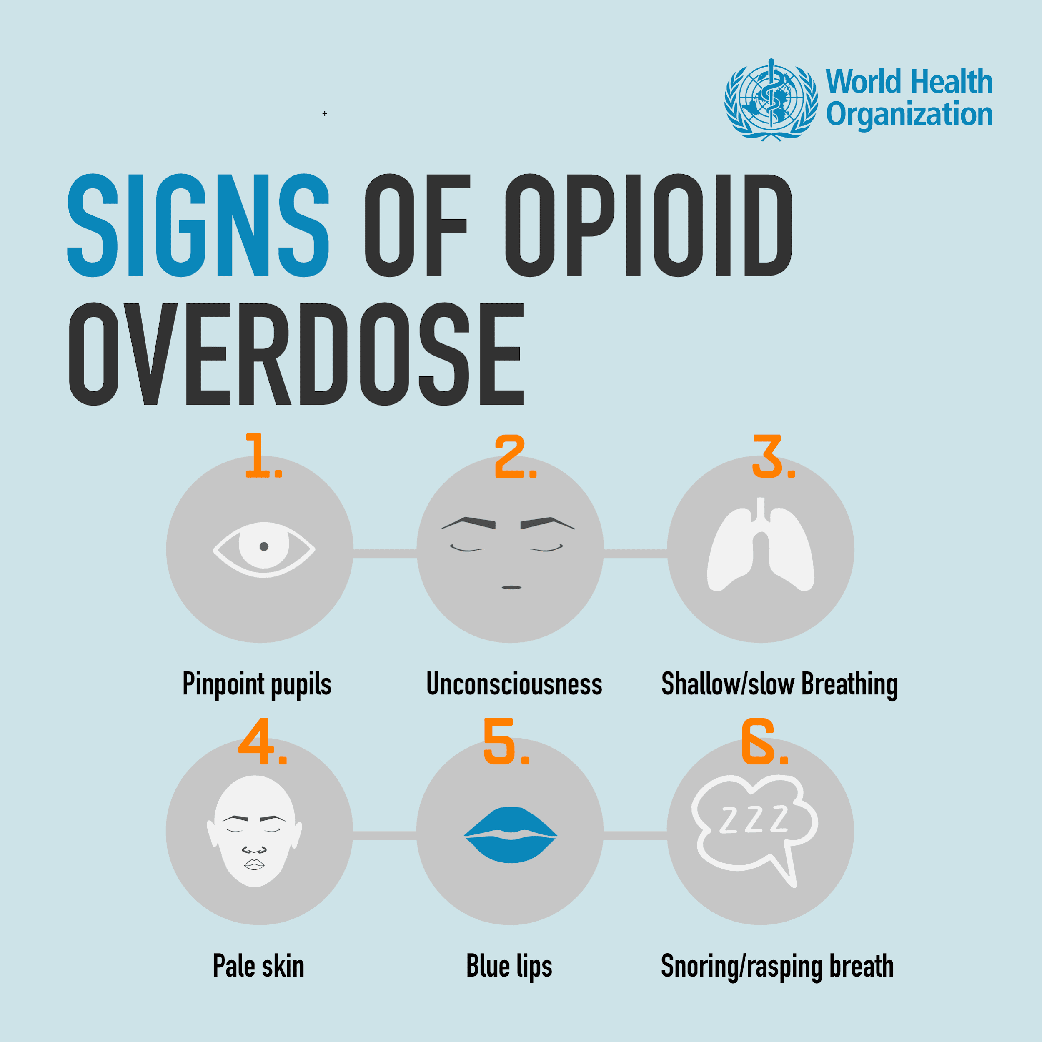
Signs of Opioid Overdose
Señales de una Sobredosis por Opioides
Recognizing the signs of opioid overdose
can save a life.
Here are some signs to look for:
Small, constricted "pinpoint pupils"
Falling asleep or losing consciousness
Slow, weak, or no breathing
Vomiting
Limp body
Cold and/or clammy skin
Purple or blueish lips and/or fingernails
Reconocer las señales de sobredosis por opioides puede salvar una vida.
Están son las señales a las que debería estar atento:
Pupilas de los ojos dilatadas, pequeñitas
Quedarse dormido o perder el sentido
Respiración débil, lenta o sin respiración
Vómito
Cuerpo inerte
Piel fría y/o húmeda
Labios/uñas de los dedos morados o azules
Departamento de Salud Pública de California https://www.cdph.ca.gov/Programs/OPA/Pages/Communications-Toolkits/Fentanyl-Overdose-Prevention.aspx
Notes:
Facilitator Notes:
Some of us have heard or seen on television news about people overdosing on fentanyl. Tragically, it has happened in some of our schools, too.
Because of the increase in fentanyl use and overdose caused by fentanyl, it is important that we are all aware of the signs of an opioid overdose. It can save a life!
However, besides fentanyl, a wide range of substances like alcohol, prescription medications and illegal medications, can also cause an overdose.
Sometimes it can be difficult to tell whether a person is very high or experiencing an overdose.
If you're having a hard time telling the difference, it is best to treat the situation like an overdose and call 911 - it could save someone's life.
Briefly review the common signs of overdose.
CA Dept of Public Health
https://www.cdph.ca.gov/Programs/OPA/Pages/Communications-Toolkits/Fentanyl-Overdose-Prevention.aspx
KRB Note: Be sure we have permission to use the image.

Slide 33
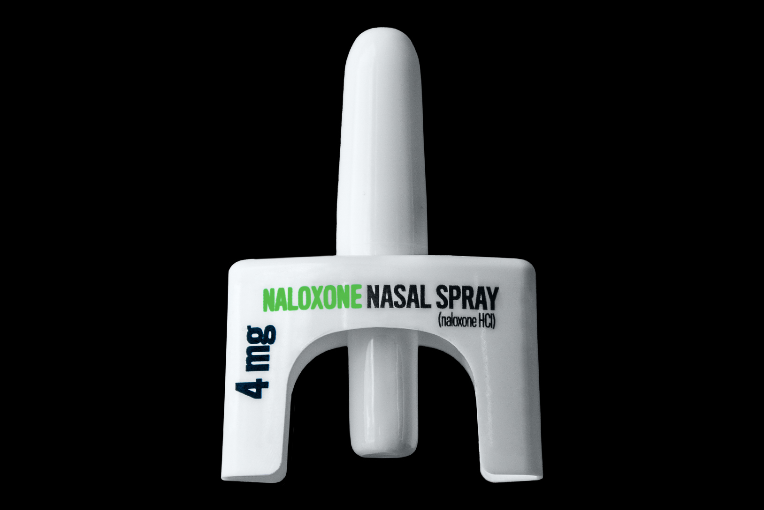
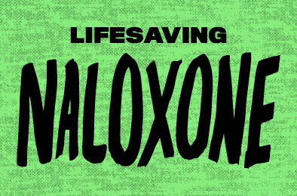
Naloxone
Naloxona
What is Naloxone
Naloxone is a medicine that can help people who are overdosing on an opioid. Opioids include prescription medications, heroin, and fentanyl. Narcan temporarily reverses the effects of an overdose from opioids.
Naloxone can be administered by a prefilled devices that sprays medication into the nose.
Naloxone is safe. Naloxone will not harm someone if you give it to them and they are not overdosing on an opioid.
Naloxone is one important step when helping someone who is overdosing.
If you have Naloxone, you can potentially save a life.
¿Qué es la Naloxona?
La naloxona, por ejemplo, Narcan, es un medicamento que puede ayudar a las personas que están sufriendo de una sobredosis de un opioide. Los opioides incluyen medicamentos recetados, heroína y fentanilo. Narcan revierte temporalmente los efectos de una sobredosis de opioides.
La naloxona/Narcan se puede administrar mediante dispositivos precargados que rocíen el medicamento dentro de la nariz.
La naloxona es segura. La naloxona no le hará daño a alguien si usted la administra y no está sufriendo de una sobredosis por un opioide.
La naloxona es un paso importante al ayudar a alguien que está pasando por una sobredosis.
Si usted tiene naloxona/Narcan, usted puede potencialmente salvar una vida.
Naloxone Training: https://lausd.csod.com/ui/lms-learning-details/app/curriculum/19788849-b116-4dc3-b737-ce25a479e6df
CDC: 5 Things to Know About Naloxone | Feature Topics | Drug Overdose (cdc.gov)
Notes:
Facilitator Notes:
Read the slide
CA Dept of Public Health
https://www.cdph.ca.gov/Programs/OPA/Pages/Communications-Toolkits/Fentanyl-Overdose-Prevention.aspx

Slide 34
What can
parents/caregivers do?
¿Qué pueden hacer los padres/proveedores de cuidado?
Notes:
Facilitator Notes:
Talking about substance use with your child may feel difficult for many reasons, but it is an important step toward prevention.
It is never too early to talk to your children about drugs. Research shows that kids who receive clear messages about the dangers of substances early and often at home are 50% less likely to use drugs.
Having open and honest conversations is one of the most powerful ways to connect with our children and help them make healthy choices.

Slide 35
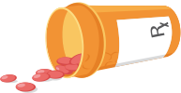
Speak with Your Child Early On
Hable con sus Hijos con Tiempo
Kids as young as preschool age can learn that:
You only take medicine when you’re sick, and only if your parent or doctor gives it to you. Taking medicine by yourself, taking the wrong medicine or taking medicine that isn’t especially for you is dangerous.
Just because it’s in a family’s or friend's medicine cabinet doesn’t mean that it is safe for you to take.
The misuse of medication, even just one time, can lead to serious illness or death.
Medication misuse includes:
Taking someone else’s medicine
Using medicine in a way other than prescribed/directed
Taking medicine to get high, or mixing medicine with alcohol or other substances.
Los niños hasta de edad preescolar pueden aprender que:
Solamente se toma medicina cuando se está enfermo, y solamente si su papá o mamá o doctor se la administra. Tomar medicina por cuenta propia, tomar medicina equivocada, o tomar medicina que no es para ti es muy peligroso.
El hecho que esté [el medicamento] en el botiquín de la familia o amigo no significa que sea segura para que tú la tomes.
El uso indebido de los medicamentos, incluso solo una vez, puede resultar en enfermedad o muerte.
El uso indebido de medicamentos incluye:
Tomar la medicina recetada a otra persona
Usar la medicina de una manera que no sea la recetada/definida
Tomar la medicina para drogarse, o mezclarla con alcohol u otras sustancias.
Drug Enforcement Administration. Prescription for Disaster: How Teens Misuse Medicine 2018 Edition. https://www.getsmartaboutdrugs.gov/sites/getsmartaboutdrugs.com/files/publications/DEA_PrescriptionForDisaster-2018ed_508_0.pdf
Notes:
Facilitator Key Points:
You can protect your children by sending a clear message about medication from an early age. Children as young as preschool age can learn that:
You only take medicine when you are sick, and only if your parent or doctor gives it to you.
Taking medicine by yourself, taking the wrong medicine or taking medicine that isn’t specifically for you is dangerous.
Just because it’s in a family’s or friend's medicine cabinet doesn’t mean that it is safe for you to take.
The misuse of medication, even just one time, can lead to serious illness or death.
Medication misuse includes: Taking someone else’s medicine , using medicine in a way other than prescribed/directed , taking medicine to get high, or mixing medicine with alcohol or other substances.

Slide 36

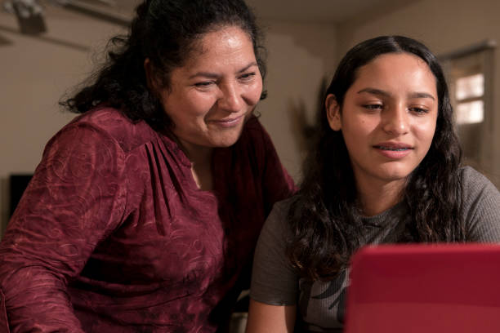
Tips on How to Talk to Your Child
Consejos Sobre Cómo Hablar con su Estudiante
Before the talk…
Know the facts.
Be patient and ready to listen.
Set a positive example.
Start the conversation…
Find the right moment
Ask for support
Keep the conversation going
Antes de tener la charla...
Conozca los datos
Tenga paciencia y esté listo para escuchar
Dé un ejemplo positivo
Inicie la conversación…
Encuentre el momento que sea indicado
Busque apoyo
Siga con la conversación
Surgeon General
https://e-cigarettes.surgeongeneral.gov/documents/SGR_Ecig_ParentTipsheet_508.pdf
Notes:
Facilitator Notes:
Know the facts.
Get credible information
Be patient and ready to listen.
Avoid criticism and encourage an open dialogue.
Remember, your goal is to have a conversation, not to deliver a lecture.
It's OK for your conversation to take place over time, in bits and pieces.
Set a positive example. If you use substances, it’s never too late to quit.
START THE CONVERSATION…
Find the right moment.
A more natural discussion will increase the likelihood that your teen will listen. Rather than saying “we need to talk,” you might ask your teen what he or she thinks about a situation you witness together, such as:
Seeing someone use in person or in a video.
Passing a shop when you are walking or driving.
Seeing advertisement in a store or magazine or on the internet.
Ask for support.
Not sure where to begin? Ask your health care provider to talk to your teen.
You might also suggest that your teen talk with other trusted adults, such as relatives, teachers, faith leaders, coaches, or counselors.
Answer your child's questions.
Keep the Conversation Going
Many parents find that texting is a great way to reach their teens. You can easily share pages of the website with your teen.
https://e-cigarettes.surgeongeneral.gov/documents/SGR_Ecig_ParentTipsheet_508.pdf

Slide 37
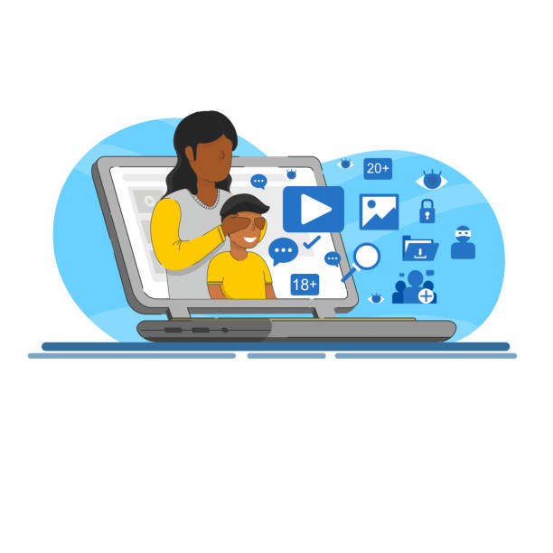
Tips for Monitoring the Use of Social Media
Consejos para Dar Seguimiento al Uso de las Redes Sociales
What you can do to protect your child:
Know where your teen is at all times - physically and virtually.
Get to know your kids’ friends — both online and off.
Find out how your teen plans to spend his or her day.
Limit the time your child spends without adult supervision.
Know the apps and other technology your teen is using — and use it yourself.
Know how much money your child has and how that money is spent.
Lo que usted puede hacer para proteger a su estudiante:
Esté al tanto sobre dónde está su adolescente en todo momento - física y virtualmente.
Conozca a las amistades de su estudiante - tanto en línea como en persona.
Averigüe cómo su adolescente planea pasar su día.
Limite el tiempo que el estudiante pasa sin supervisión de un adulto.
Conozca las aplicaciones y otra tecnología que usa su adolescente - y úselas usted.
Esté al tanto de la cantidad de dinero que su estudiante tiene y cómo lo gasta.
Resources:
Drugfree.org: Partnership to End Addiction
https://drugfree.org/article/setting-limits-and-monitoring-behavior/
Notes:
Facilitator Notes:
Knowing where your child is at all times is an important part of supervision.
The most important time of day to monitor is after school. Kids are at the greatest risk for using substances during these hours.
Get to know your child’s friends and their parents to check that they have similar views on substance use.
Find out how your teen plans to spend his or her day: “What are you planning to do tomorrow that you’re excited about?
Limit the time your child spends without adult supervision. If you or another adult you trust can’t be home with your child, explore afterschool programs. If that’s not possible, try to check in on your child periodically when they’re home alone.
Pay attention to the types of social media and other apps your child is using and make sure they are using them within established limits and guidelines that you’ve set. Depending on your child’s age, it can be appropriate to know their passwords and scan their apps from time to time to check for unhealthy or unsafe activity.
Have your child bring you receipts for any purchases made or use a debit card where you can see where and when they use it.
Additional Facilitator Notes:
Invite participants to share responses to any or all of the following questions:
Do you know the social media platforms their child has?
Do you have access to the accounts and if so, how do you monitor them?
Have you ever discovered a second account or a secret account your child had?
Resources:
Drugfree.org: Partnership to End Addiction
https://drugfree.org/article/setting-limits-and-monitoring-behavior/

Slide 38
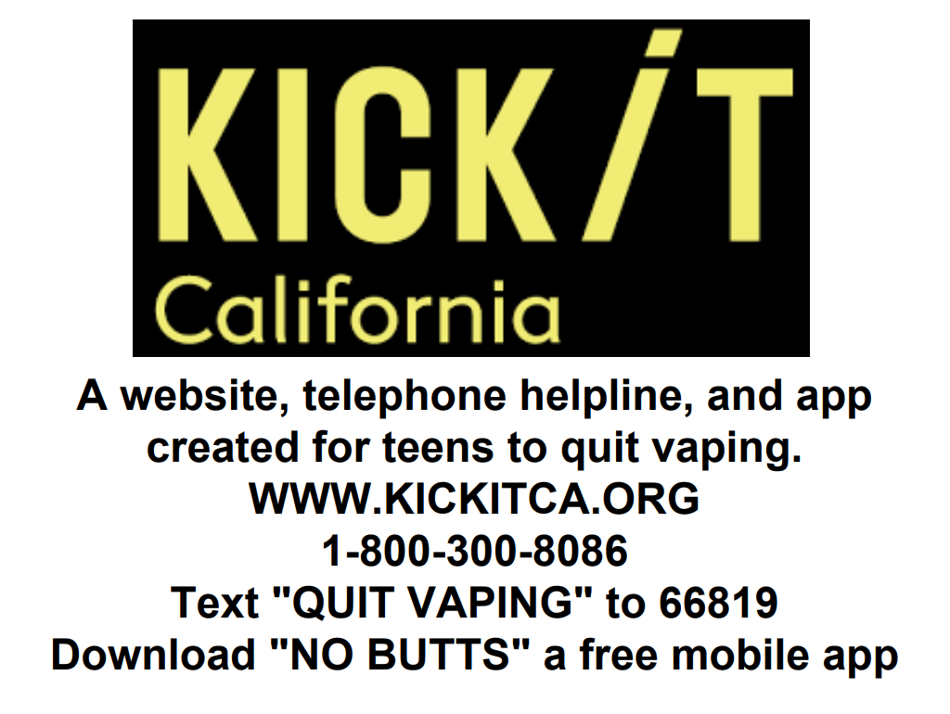
Resources for Students
Resources at Schools:
Counselors, Psychiatric Social Workers, Psychologists, Restorative Justice Coordinators, administrators, etc.
LAUSD Resource Hotline:
askshhs.lausd.net
L.A. Unified Student and Family Wellness Hotline
(213) 241-3840
Monday-Friday, 8am-4:40pm
Press 2 for Mental Health
LAUSD Wellness Centers:
https://achieve.lausd.net/wellnesscenters
LAUSD Student Wellbeing Centers:
https://achieve.lausd.net/Page/18469
Community Resources:
SAMHSA National Helpline
1-800-662-HELP (4357)
Smoke Free Teen
https://TEEN.SMOKEFREE.gov
TEXT “QUIT” TO 47848
Notes:
Facilitator Notes:
There are community health organizations that provide substance abuse support and mental health services. Some organizations are national, while others are based only in California.
Some organizations accept medical or other forms of payment. LAUSD does not assume responsibility for the services the organizations provide or for the fees they charge. LAUSD does not endorse any of the organizations.
LAUSD Wellness Centers: https://achieve.lausd.net/wellnesscenters

Slide 39
Recursos para los Estudiantes
Recursos en las escuelas:
Consejeros, trabajadores sociales en psiquiatría, psicólogos, coordinadores de Justicia Restaurativa, administradores, etc.
Línea Directa de Recurso del LAUSD:
askshhs.lausd.net
Línea Directa de Bienestar de los Estudiantes y Familias del Distrito Unificado de Los Ángeles
(213) 241-3840
Lunes a viernes, 8am-4:40pm
Presione 2 para la Salud Mental
Centros de LAUSD para Bienestar:
https://achieve.lausd.net/wellnesscenters
Centros de Bienestar Estudiantil de LAUSD:
https://achieve.lausd.net/Page/18469
Recursos de la Comunidad:
Línea de Ayuda Nacional SAMHSA
1-800-662-HELP (4357)
Adolescente que no fuma
https://TEEN.SMOKEFREE.gov
Enviar en texto la palabra QUIT a 47848
Notes:
Facilitator Notes:
There are community health organizations that provide substance abuse support and mental health services. Some organizations are national, while others are based only in California.
Some organizations accept medical or other forms of payment. LAUSD does not assume responsibility for the services the organizations provide or for the fees they charge. LAUSD does not endorse any of the organizations.
LAUSD Wellness Centers: https://achieve.lausd.net/wellnesscenters

Slide 40


Growing Up Drug Free:
A Parent’s Guide to Prevention
Adolescents who have a good bond with an adult are less likely
to engage in risky behaviors.
Tell your children you don’t want them drinking or using drugs. Explain to them how you feel and what you expect from them.
Spend time with your children and learn what is going on in their lives.
If your children think you will be there for them, they will be more likely to talk to you about drugs or situations that make them feel uncomfortable.
U.S. Department of Justice Drug Enforcement Administration
https://www.dea.gov/sites/default/files/2018-06/growing-up-drug-free-2017.pdf
Notes:
https://www.dea.gov/sites/default/files/2018-06/growing-up-drug-free-2017.pdf

Slide 41
Crecer Libre de Drogas:
Una Guía para los Padres Sobre la Prevención
Los adolescentes que tienen una buena conexión con un adulto tienen menores probabilidades de participar en comportamientos de riesgo.
Comuníqueles a sus hijos que usted no quiere que ellos beban alcohol o usen drogas. Explíqueles cómo se siente y qué es lo que usted espera de ellos.
Pase tiempo con sus hijos y aprenda lo que está sucediendo en sus vidas.
Si sus hijos piensan que usted está dispuesto a ayudarlos, será más probable que se acerquen a usted para hablar sobre las drogas y situaciones que los hacen sentirse incómodos.
Administración para el Control de Drogas del Departamento de Justicia de los EE. UU.
https://www.dea.gov/sites/default/files/2018-06/growing-up-drug-free-2017.pdf
Notes:
https://www.dea.gov/sites/default/files/2018-06/growing-up-drug-free-2017.pdf

Slide 42


Slide 43

Questions…
Maya Rosas
T.U.P.E. Coordinator
Beyond the Bell
mdr3802@lausd.net
(213) 241-3029
Francisca Gamez
High School Field Coordinator
Beyond the Bell
fxg9203@lausd.net
(213) 241-3111
Daniel Soto
Project Director
Institute for Health Promotion and
Disease Prevention Research
USC Keck School of Medicine
School Presenter Name
Title
Phone Number
Name of School
email address
(213) 241-3029
Notes:
Facilitator Notes:
Include the presenting school’s contact information in this slide.

